Slide 1
Pytorch autograd
AUTOMATIC DIFFERENTIATION
Gene Olafsen

Slide 2
Reference Material
https://www.residentmar.io/2019/07/07/python-mixins.html
https://towardsdatascience.com/pytorch-autograd-understanding-the-heart-of-pytorchs-magic-2686cd94ec95

Slide 3
defined
"The autograd package provides automatic differentiation for all operations on Tensors. It is a define-by-run framework, which means that your backprop is defined by how your code is run, and that every single iteration can be different." --Pytorch Documentation

Slide 4
Background
PyTorch Model Composition
PyTorch Overloaded Operators

Slide 5
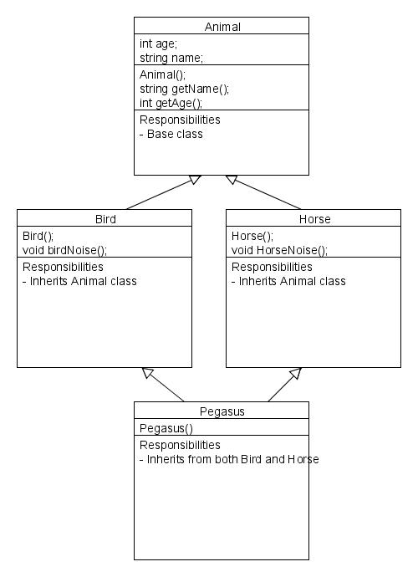
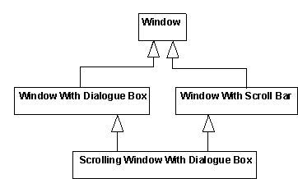
Multiple inheritance
So called "Diamond of Death"

Slide 6
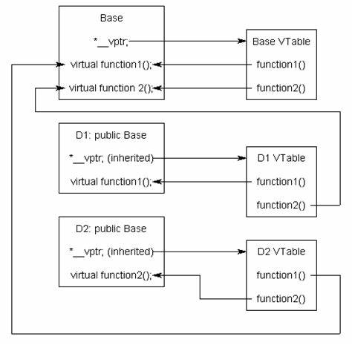
V-table
In this diagram:
D1 overrides function1 and provides its own implementation. It inherits function2 from the base.
D2 inherits function1 from the base and implements its own version of function2.

Slide 7
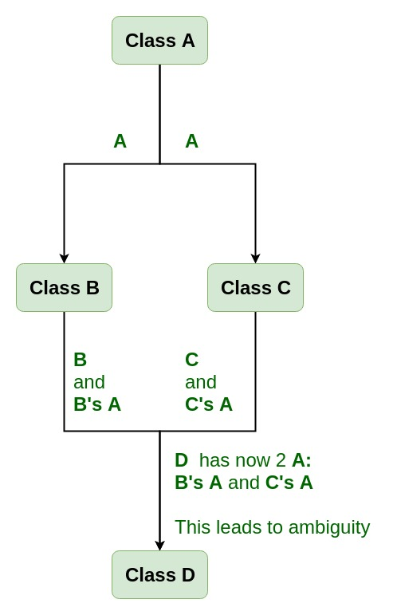
Virtual Base Class
Virtual base classes are used in virtual inheritance in a way of preventing multiple “instances” of a given class appearing in an inheritance hierarchy when using multiple inheritances.
class B : virtual public A { }; class C : public virtual A { };

Slide 8
Python multiple inheritance
class SuperClassA: def __init__(self): self.a = 1 class SuperClassB: def __init__(self): self.b = 1 class SubClass(SuperClassA, SuperClassB): def __init__(self): super().__init__() obj = SubClass() # trivia question: which of self.a and self.b is defined?

Slide 9
Python multiple inheritance solution
Python solves this problem using a scary-sounding algorithm called C3 linearization, but this is a fragile solution.
It is very easy to change or add or rename a method on a class, or to modify an inheritance hierarchy in some way, and in doing so inadvertently change which parent's version of a function or attributed is being called on in your code.

Slide 10
Guido van rossum
Python's Guido van Rossum summarizes C3 superclass linearization thusly:
Basically, the idea behind C3 is that if you write down all of the ordering rules imposed by inheritance relationships in a complex class hierarchy, the algorithm will determine a monotonic ordering of the classes that satisfies all of them. If such an ordering can not be determined, the algorithm will fail.

Slide 11
Avoiding multiple inheritance
Single inheritance can be used to avoid the pitfalls of multiple inheritance. The downside is that you may end up with a deep inheritance chain or many different class heirarchies where each class relies on a subset of library features.

Slide 12
mixins
Mixins are an alternative class design pattern that avoids both single-inheritance class fragmentation and multiple-inheritance diamond dependencies.
A mixin is a class that defines and implements a single, well-defined feature. Subclasses that inherit from the mixin inherit this feature—and nothing else.
By convention, mixins in python end in "Mixin"

Slide 13
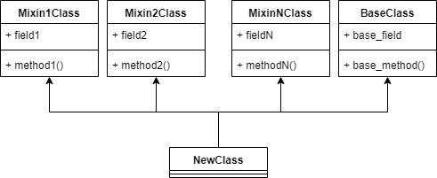
Mixin Single Responsibility

Slide 14
Mixin advantage
Mixins are a safe form of multiple inheritance.
They enforce a new constraint on your classes: that all functionality relating to a specific feature must live in the appropriate mixin. Thus methods thus can't be defined in more than one place, and thus can't fall prey to diamond inheritance problems.
Mixins are more legible than single inheritance classes.
Flat "single-level" inheritance (courtesy of multiple inheritance!) and clear division of labor on a feature-to-feature basis makes it obvious which parent class is responsible for which object properties. In fact, mixins make it so obvious which features an object supports that oftentimes you can read it right off of the class signature:

Slide 15
Mixin code Example
# supports no optional parameters class SimpleDiagram(Plot) # supports 'hue', 'legend', and 'clip' optional parameters class LegendDiagram(Plot, HueMixin, LegendMixin, ClipMixin) # supports 'hue', 'scale', and 'legend' optional parameters class CartogramDiagram(Plot, HueMixin, ScaleMixin, LegendMixin)

Slide 17
Overloaded operators
Just like NumPy, PyTorch overloads a number of python operators to make PyTorch code shorter and more readable.
What
Operator Overloading means giving extended meaning beyond their predefined operational meaning.

Slide 18
Operators
z = -x # z = torch.neg(x) z = x + y # z = torch.add(x, y) z = x - y z = x * y # z = torch.mul(x, y) z = x / y # z = torch.div(x, y) z = x // y z = x % y z = x ** y # z = torch.pow(x, y) z = x @ y # z = torch.matmul(x, y) z = x > y z = x >= y z = x < y z = x <= y z = abs(x) # z = torch.abs(x) z = x & y z = x | y z = x ^ y # z = torch.logical_xor(x, y) z = ~x # z = torch.logical_not(x) z = x == y # z = torch.eq(x, y) z = x != y # z = torch.ne(x, y)
Combined operators execute overloads as well.
x += y
x **= 2
Note: Python doesn’t allow overloading and, or, and not keywords.

Slide 19
# Python code illustrating how
# to overload the + operator
class MyCombine:
def __init__(self, a):
self.a = a
# combine two objects
def __add__(self, o):
return self.a + o.a
obj1 = MyCombine(1)
obj2 = MyCombine(2)
obj3 = MyCombine("Hello")
obj4 = MyCombine("World")
print(obj1 + obj2)
print(obj3 + obj4)
3
HelloWorld

Slide 21
Pytorch Tensors
N-dimensional array
Support additional enhancements
Can be loaded or the GPU for faster computations.
On setting .requires_grad = True they start forming a backward graph that tracks every operation applied on them to calculate the gradients via a dynamic computation graph (DCG)
Note: PyTorch only allows gradients to be calculated for floating point tensors.

Slide 22
Deprecated pytorch Variable Class
In earlier versions of PyTorch, the torch.autograd.Variable class was used to create tensors that support gradient calculations and operation tracking.
As of PyTorch v0.4.0 the Variable class has been deprecated.
torch.Tensor now contains the functionality of torch.autograd.Variable

Slide 23
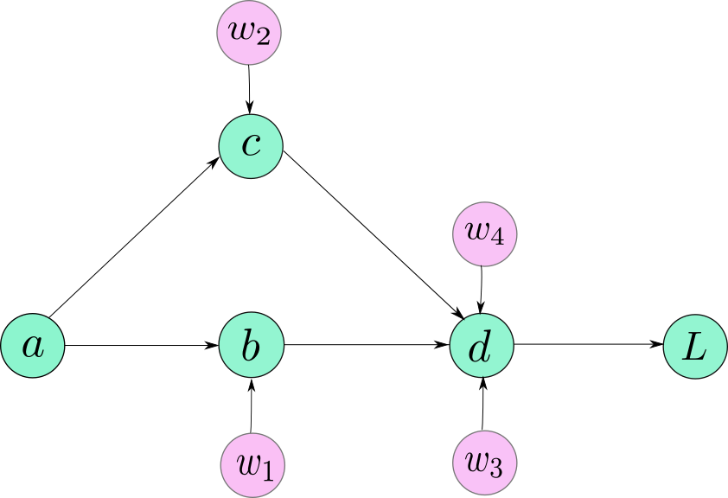
Autograd class
An engine to calculate derivatives (Jacobian-vector product).
Autograd records a graph of all the operations performed on gradient enabled tensors and creates an acyclic graph.
The leaves of this graph are input tensors
The roots of this graph are output tensors.
Gradients are calculated by tracing the graph from the root to the leaf and multiplying every gradient in the way using the chain rule.

Slide 24
Neural network training refresher
Define the architecture
Forward propagate on the architecture using input data
Calculate the loss
Backpropagate to calculate the gradient for each weight
Update the weights using a learning rate

Slide 25
Training Iteration
The Dynamic Computation Graph (DCG) is built from scratch in every iteration providing maximum flexibility to gradient calculation.
Consider the following code. The forward multiplication operation is performed by a Pytorch overload named Mul. PyTorch's backward operation named MulBackward is dynamically integrated in the backward graph for computing the gradient.
import torch # Creating the graph x = torch.tensor(1.0, requires_grad = True) y = torch.tensor(2.0) z = x * y

Slide 26
Hence
You don’t have to encode all possible paths before you launch the training — what you run, is what you differentiate.
If your forward method had branching logic in it, only the codepath that is executed, contributes to the computation graph.

Slide 27
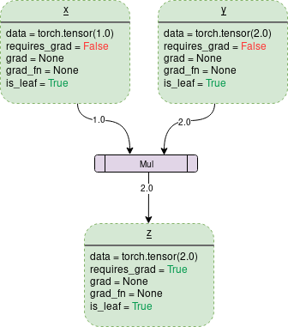
Requires_grad = false
data: a 1x1 tensor holding values of either 1.0 or 2.0
drad: contains the value of the gradient.
grad_fn: identifies the 'backward' function to calculate the gradient.
is_leaf: A node is leaf if :
It was initialized explicitly by some function like x = torch.tensor(1.0) or x = torch.randn(1, 1)
It is created after operations on tensors which all have requires_grad = False.
It is created by calling .detach() method on some tensor.

Slide 28
Back'ward' to the future
Let's get ready to turn the requires_grad = True
The backward() function is responsible for calculating the gradient.
On calling backward(), gradients are populated only for the nodes which have both:
requires_grad = True
is_leaf = True.
Gradients are of the output node from which .backward() is called, with respect to other leaf nodes.

Slide 29
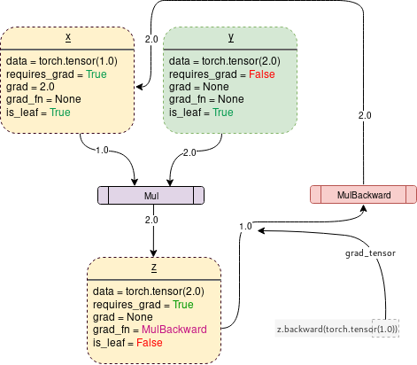
Requires_grad = true
On turning requires_grad = True PyTorch will start tracking the operation and store the gradient functions at each step.
import torch # Creating the graph x = torch.tensor(1.0, requires_grad = True) y = torch.tensor(2.0) z = x * y

